Slide 1

Comprehensive Analysis of NYPD Arrests
A Deep Dive into Demographics, Crime Details, Temporal Trends, Geographical Patterns, and Jurisdictional Aspects

Slide 2
OBJECTIVE
The primary objective of my analysis is to uncover patterns and insights in the New York Police Department’s arrests data. I aim to answer several key questions:
What are the demographics of individuals who have been arrested?
What types of crimes are most common, and how do these vary by borough and over time?
Are there temporal patterns in the occurrence of crimes?
How do crime rates vary geographically?
How do crime rates vary across different jurisdictions?
By answering these questions, I hope to provide a comprehensive overview of crime trends in New York City, which could inform policy decisions and law enforcement strategies.

Slide 3
FINDINGS
My findings are organized into five main categories:
Arrest Demographics: I analyse the average age of arrested individuals by sex and the number of crimes committed by race.
Crime Details: I identify the most common offenses and how these vary by borough. I also examine the distribution of crimes by law category, PD code, KY code, and law code.
Temporal Analysis: I explore how the number of crimes varies by month and day of the week.
Geographical Analysis: I investigate the number of arrests by borough and the top locations with the highest number of crimes. I also identify the precincts with the highest number of arrests.
Jurisdiction Analysis: I analysed the number of crimes committed at each jurisdiction.
Each of these categories provides a different perspective on the arrests data, revealing a multifaceted picture of crime in New York City.

Slide 4
METHODOLOGY
My analysis is based on SQL queries performed on the nypd_arrests dataset. I use a variety of SQL techniques, including aggregate functions, window functions, and common table expressions (CTEs), to extract meaningful information from the data. I also use self-joins to compare rows within the same table.

Slide 5
DATA DICTIONARY
Field Name | Description
ARREST_KEY | Randomly generated persistent ID of each Arrest
ARREST_DATE | Exact date of arrest for the reported event
PD_CD | Three digit internal classification code ( more granular than Key Code)
PD_DESC | Description of internal classification corresponding with PD code (more granular than Offense Description)
KY_CD | Three digit internal classification code (more general category than PD code)
OFNS_DESC | Description of internal classification corresponding with KY code (more general category than PD description)
LAW_CODE | Law code charges corresponding to the NYS Penal Law, VTL and other various local laws
LAW_CAT_CD | Level of offence: felony, misdemeanor, violation

Slide 6
Field Name | Description
ARREST_BORO | Borough of arrest. B(Bronx), S(Staten Island), K(Brooklyn), M(Manhattan), Q(Queens)
ARREST_PRECINCT | Precinct where the arrest occurred
JURISDICTION_CODE | Jurisdiction responsible for arrest. Jurisdiction codes 0(Patrol), 1(Transit) and 2(Housing) represents NYPD whilst codes 3 and more represent non NYPD jurisdictions
AGE_GROUP | Perpetrator’s age within a category
PREP_SEX | Perpetrator’s sex description
PREP_RACE | Perpetrator's race description
X_COORD_CD | Midblock X-coordinate for New York State Plane Coordinate System, Long Island Zone, NAD 83, units feet (FIPS 3104)
Y_COORD_CD | Midblock Y-coordinate for New York State Plane Coordinate System, Long Island Zone, NAD 83, units feet (FIPS 3104)
Latitude | Latitude coordinate for Global Coordinate System, WGS 1984, decimal degrees (EPSG 4326)
Longitude | Longitude coordinate for Global Coordinate System, WGS 1984, decimal degrees (EPSG 4326)

Slide 7
ANALYSIS
Arrest Demographics
This category focuses on the characteristics of the individuals who were arrested.

Slide 8
Average Age of Arrested Person by Sex
PERP_SEX | Avg_Age
F | 27
M | 28
U | 28
SELECT PERP_SEX, ROUND(AVG(AGE_GROUP)) AS Avg_Age
FROM nypd_arrests
GROUP BY PERP_SEX;

Slide 9
Crime Committed by Race
PERP_RACE | Num_Crimes
BLACK | 82041
BLACK HISPANIC | 16501
WHITE HISPANIC | 43081
WHITE | 16373
ASIAN / PACIFIC ISLANDER | 9066
AMERICAN INDIAN/ALASKAN NATIVE | 552
UNKNOWN | 2481
SELECT PERP_RACE, COUNT(*) AS Num_Crimes
FROM nypd_arrests
GROUP BY PERP_RACE;

Slide 10
Top 5 Crimes committed by Males
OFNS_DESC | Num_Crimes
ASSAULT 3 & RELATED OFFENSES | 18148
PETIT LARCENY | 13411
FELONY ASSAULT | 11446
DANGEROUS DRUGS | 10064
MISCELLANEOUS PENAL LAW | 9367
SELECT OFNS_DESC, COUNT(*) AS Num_Crimes
FROM nypd_arrests
WHERE PERP_SEX = 'M'
GROUP BY OFNS_DESC
ORDER BY Num_Crimes DESC
LIMIT 5;

Slide 11
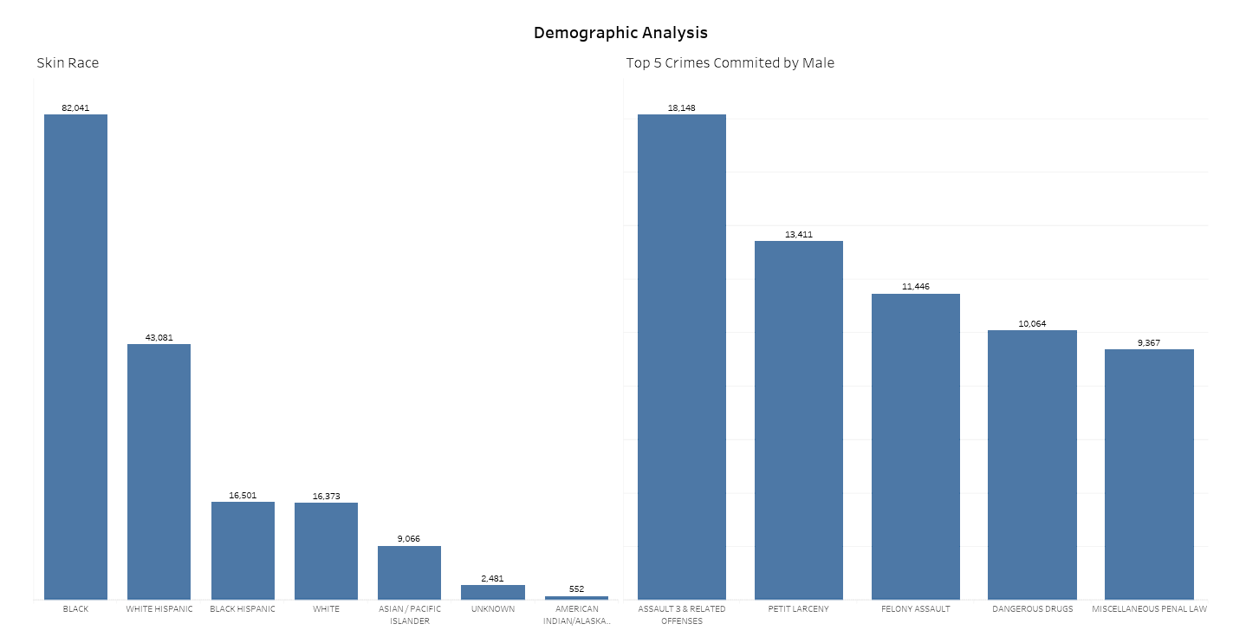

Slide 12
Crimes Committed by Specific Races (Black and White)
PERP_RACE | Num_Crimes
BLACK | 82041
WHITE HISPANIC | 43081
BLACK HISPANIC | 16501
WHITE | 16373
SELECT PERP_RACE, COUNT(*) AS Num_Crimes
FROM nypd_arrests
WHERE PERP_RACE LIKE "%White%" OR PERP_RACE LIKE "%Black%"
GROUP BY PERP_RACE
ORDER BY Num_Crimes DESC;

Slide 13
ANALYSIS
Crime Details
This category focuses on the specifics of the crimes that were committed.

Slide 14
Most Common Offense
SELECT OFNS_DESC, COUNT(*) AS Frequency
FROM nypd_arrests
GROUP BY OFNS_DESC
ORDER BY Frequency DESC
LIMIT 1;
OFNS_DESC | Frequency
ASSAULT 3 & RELATED OFFENSES | 25200

Slide 15
Top 10 Offenses in NYPD Jurisdiction
Offence | Frequency
ASSAULT 3 & RELATED OFFENSES | 23502
PETIT LARCENY | 17770
FELONY ASSAULT | 15027
DANGEROUS DRUGS | 10701
MISCELLANEOUS PENAL LAW | 10337
VEHICLE AND TRAFFIC LAWS | 9154
ROBBERY | 8004
CRIMINAL MISCHIEF & RELATED OF | 7754
GRAND LARCENY | 7693
DANGEROUS WEAPONS | 6894
SELECT OFNS_DESC AS Offence , COUNT(*) AS Frequency
FROM nypd_arrests
WHERE JURISDICTION_CODE IN (0,1,3)
GROUP BY Offence
ORDER BY Frequency DESC
LIMIT 10;

Slide 16
Top 10 Offenses in NON-NYPD Jurisdiction
Offence | Frequency
ASSAULT 3 & RELATED OFFENSES | 1698
FELONY ASSAULT | 1003
DANGEROUS DRUGS | 825
MISCELLANEOUS PENAL LAW | 795
OFFENSES AGAINST PUBLIC ADMINI | 638
CRIMINAL MISCHIEF & RELATED OF | 579
DANGEROUS WEAPONS | 351
CRIMINAL TRESPASS | 295
VEHICLE AND TRAFFIC LAWS | 288
PETIT LARCENY | 255
SELECT OFNS_DESC AS Offence , COUNT(*) AS Frequency
FROM nypd_arrests
WHERE JURISDICTION_CODE NOT IN (0,1,3)
GROUP BY Offence
ORDER BY Frequency DESC
LIMIT 10;

Slide 17
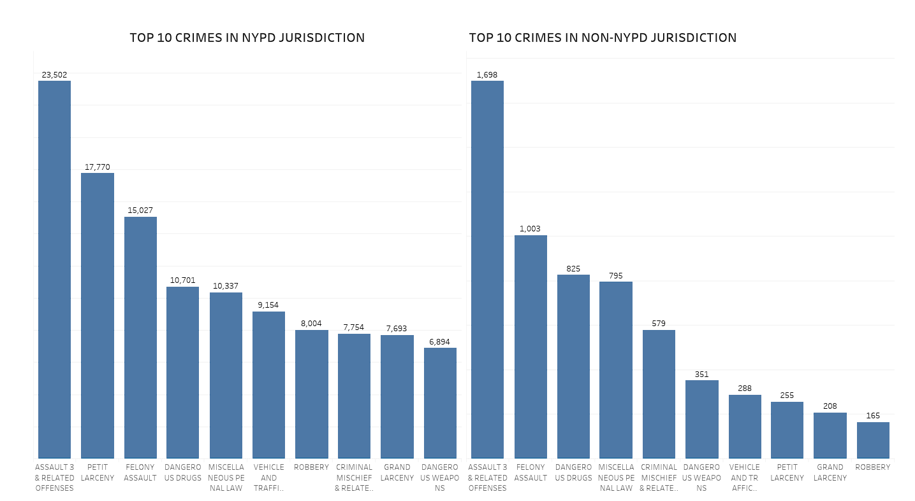

Slide 18
Most Common Crime per Borough
ARREST_BORO | OFNS_DESC | Frequency
B | ASSAULT 3 & RELATED OFFENSES | 6838
K | ASSAULT 3 & RELATED OFFENSES | 6680
M | PETIT LARCENY | 6387
Q | ASSAULT 3 & RELATED OFFENSES | 5746
S | ASSAULT 3 & RELATED OFFENSES | 992
WITH crime_frequency AS(
SELECT ARREST_BORO, OFNS_DESC, COUNT(*) AS Frequency, ROW_NUMBER() OVER(PARTITION BY ARREST_BORO ORDER BY COUNT(*) DESC) as rn FROM nypd_arrests
GROUP BY ARREST_BORO,
OFNS_DESC)
SELECT ARREST_BORO,OFNS_DESC, Frequency
FROM crime_frequency
WHERE rn = 1;

Slide 19
Crimes Committed per Law Category
LAW_CAT_CD | Num_Crimes
F | 73866
M | 93347
I | 193
V | 973
9 | 459
SELECT LAW_CAT_CD, COUNT(*) AS Num_Crimes
FROM nypd_arrests
GROUP BY LAW_CAT_CD;

Slide 20
Highest Crimes Committed per PD Code
PD_CD | Num_Crimes
101 | 18384
339 | 17957
109 | 11945
922 | 9040
397 | 8115
779 | 7047
439 | 6650
511 | 5129
113 | 4391
244 | 4240
SELECT PD_CD, COUNT(*) AS Num_Crimes
FROM nypd_arrests
GROUP BY PD_CD
ORDER BY Num_Crimes
LIMIT 10;

Slide 21

Temporal Analysis
This category focuses on the timing of the crimes.

Slide 22
Crimes Committed per Month
Month | Num_Crimes
January | 17170
February | 14999
March | 17179
April | 16281
May | 17503
June | 17570
July | 17365
August | 18022
September | 16867
October | 5624
November | 5839
December | 5676
SELECT MONTHNAME(ARREST_DATE) AS Month, COUNT(*) AS Num_Crimes
FROM nypd_arrests
GROUP BY Month;

Slide 23
Crimes Committed per Day of the Week
DayName | Num_Crimes
Sunday | 21045
Wednesday | 28618
Saturday | 21175
Monday | 21178
Thursday | 27579
Tuesday | 25897
Friday | 24603
SELECT DAYNAME(ARREST_DATE) AS DayName, COUNT(*) AS Num_Crimes
FROM nypd_arrests
GROUP BY DayName;

Slide 24
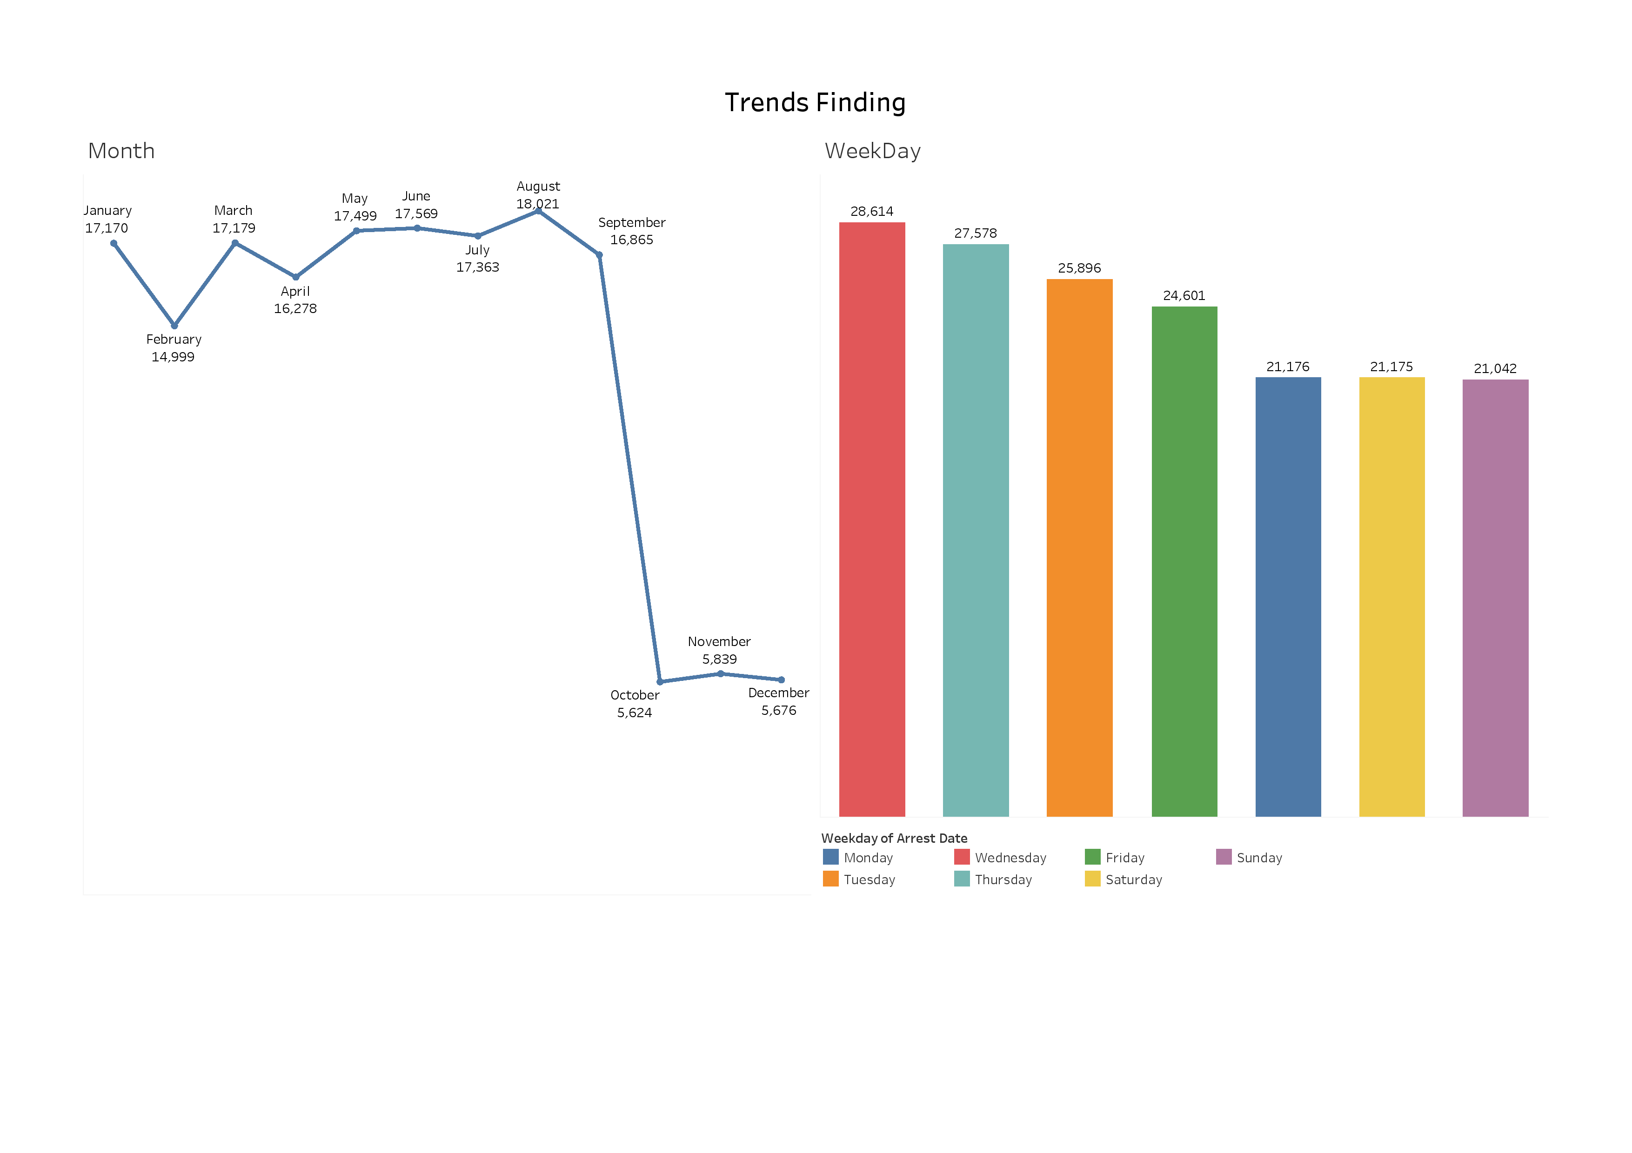

Slide 25
ANALYSIS
Geographical Analysis
This category focuses on the locations of the crimes.

Slide 26
Arrests by Borough
ARREST_BORO | Num_Arrests
K | 46825
Q | 36246
M | 39652
B | 39957
S | 7415
SELECT ARREST_BORO, COUNT(*) AS Num_Arrests
FROM nypd_arrests
GROUP BY ARREST_BORO;

Slide 27
Minor Arrests by Borough
ARREST_BORO | Num_Arrests
B | 1681
K | 1752
M | 1185
S | 374
Q | 1253
SELECT ARREST_BORO, COUNT(*) AS Num_Arrests
FROM nypd_arrests
WHERE AGE_GROUP < 18
GROUP BY ARREST_BORO;

Slide 28
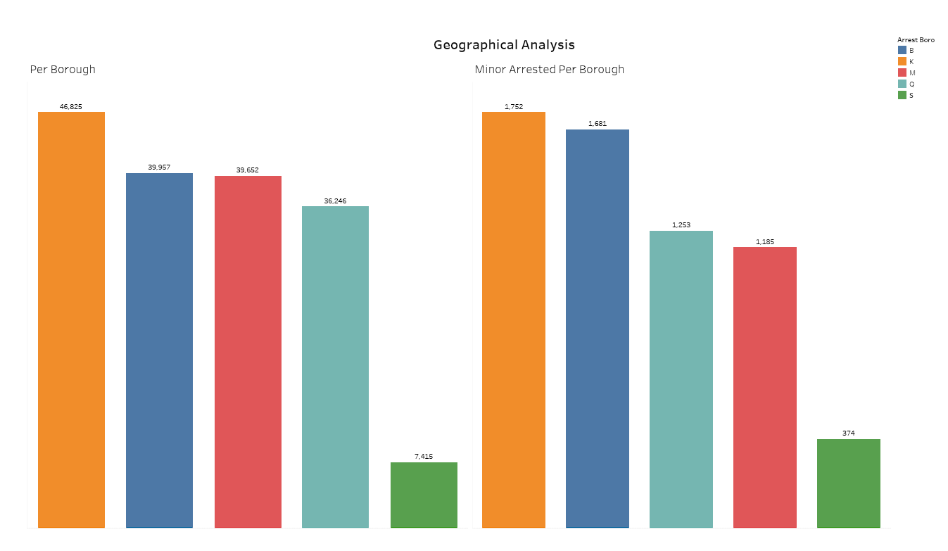

Slide 29
Top 10 Locations with Highest Number of Crimes
Latitude | Longitude | Num_Crimes
40.6714 | -73.8815 | 1150
40.8104 | -73.9249 | 1065
40.7504 | -73.9893 | 1059
40.645 | -74.0773 | 1030
40.8873 | -73.8472 | 943
40.8536 | -73.9006 | 871
40.7263 | -73.7348 | 817
40.8378 | -73.9195 | 810
40.762 | -73.8273 | 791
40.8691 | -73.8806 | 788
SELECT Latitude, Longitude, COUNT(*) AS Num_Crimes
FROM nypd_arrests
GROUP BY Latitude, Longitude
ORDER BY Num_Crimes DESC
LIMIT 10;

Slide 30
Top 10 Locations with Highest Number of Minor Arrests
Latitude | Longitude | Num_Arrests
40.645 | -74.0773 | 89
40.8104 | -73.9249 | 81
40.8234 | -73.8702 | 74
40.8378 | -73.9195 | 62
40.7339 | -74.0054 | 59
40.6714 | -73.8815 | 52
40.762 | -73.8273 | 51
40.6711 | -73.9136 | 45
40.745 | -73.8701 | 43
40.8441 | -73.9005 | 42
SELECT Latitude, Longitude, COUNT(*) AS Num_Arrests
FROM nypd_arrests
WHERE AGE_GROUP < 18
GROUP BY Latitude, Longitude
ORDER BY Num_Arrests DESC
LIMIT 10;

Slide 31
Top 5 Precincts with Highest Number of Arrests
ARREST_PRECINCT | Num_Arrests
14 | 5817
75 | 5469
44 | 5407
40 | 5392
103 | 4582
SELECT ARREST_PRECINCT, COUNT(*) AS Num_Arrests
FROM nypd_arrests
GROUP BY ARREST_PRECINCT
ORDER BY Num_Arrests DESC
LIMIT 5;

Slide 32
ANALYSIS
Geographical Analysis
This category focuses on the jurisdiction of the crimes.

Slide 33
Crimes Committed per Jurisdiction
JURISDICTION_CODE | Num_Crimes
0 | 151849
2 | 6266
11 | 267
7 | 72
14 | 86
97 | 422
3 | 1342
1 | 7968
71 | 138
15 | 267
4 | 58
72 | 376
73 | 308
87 | 183
88 | 7
85 | 10
6 | 2
69 | 7
13 | 7
79 | 1
17 | 421
74 | 2
51 | 29
52 | 7
SELECT JURISDICTION_CODE, COUNT(*) AS Num_Crimes
FROM nypd_arrests
GROUP BY JURISDICTION_CODE;

Slide 34

INSIGHTS
Most Common Offense: The most common offense leading to arrests in both NYPD and non-NYPD jurisdictions is Assault 3 & Related Offenses.
Borough with Highest Arrests: Brooklyn (K) has the highest number of arrests, including the highest number of minor arrests.
Most Arrests on Wednesday: More arrests occur in the middle of the week, with Wednesday having the most.
August has Highest Crimes: More crimes occur in the summer months, with August having the highest number.
Black Individuals Arrested More: More crimes are associated with individuals identified as Black.
Precinct 14 has Highest Arrests: Precinct 14 has the highest rate of arrests.
Average Age of Arrested Individuals: The average age of individuals who are arrested is quite similar across different genders, around 27-28 years old.

Slide 35

STORY
In 2023, New York City’s crime narrative was dominated by Assault 3 & Related Offenses. Brooklyn, known for its diversity, unfortunately led in arrests, including those of minors. Wednesdays saw the most arrests, and August recorded the highest number of crimes. A concerning trend was the higher number of crimes associated with individuals identified as Black. Precinct 14 had the highest rate of arrests, and the average age of those arrested was around 27-28 years old. These insights from 2023 serve as lessons for shaping a safer, fairer future for all New Yorkers.

Slide 36
CONCLUSION
Through this analysis, I gain valuable insights into the nature of crime in New York City. My findings highlight the importance of considering multiple factors – including demographics, crime details, temporal trends, geographical patterns and jurisdictional aspects – in understanding crime patterns. These insights could be instrumental in shaping effective strategies for crime prevention and law enforcement.

Slide 37


THANK YOU
https://www.linkedin.com/in/arka-santara
A Research Project by
Arka Santara

